Slide 1
Overview of New Accountability System
(A-F Ratings) - Part II
Webinar 9b | January 5, 2017

Slide 2
agenda – webinar 9b
PROPOSED Amendment to Commissioner Rule §101.3041
  Published on December 9, 2016, the PROPOSED amendment would
    Eliminate the phase-in of the Level II-Satisfactory Standard for STAAR
    Establish 4 “stable” performance levels or categories
    Significantly change the labels for each performance level
  Public comment period ends January 9, 2017
The New Accountability System (A-F Ratings)
  Preliminary information released December 16, 2016 (Domains I-IV)
    Data Tables, Methodology Summaries, and Targets
    lead4ward Template for predicting/confirming Domain Scores and Letter Grades
  What do the Domains mean and what can we do?
  TEA’s January 1, 2017 Legislative Report
3 Themes for Spring ’17 (our ABCs for A-F)
  Achieve
  Believe
  Conceive
  at Level II-Final (or “Meets Grade Level”)
  in student progress (no one goes backward!)
  success for all students (particularly EcoDis!)

Slide 3
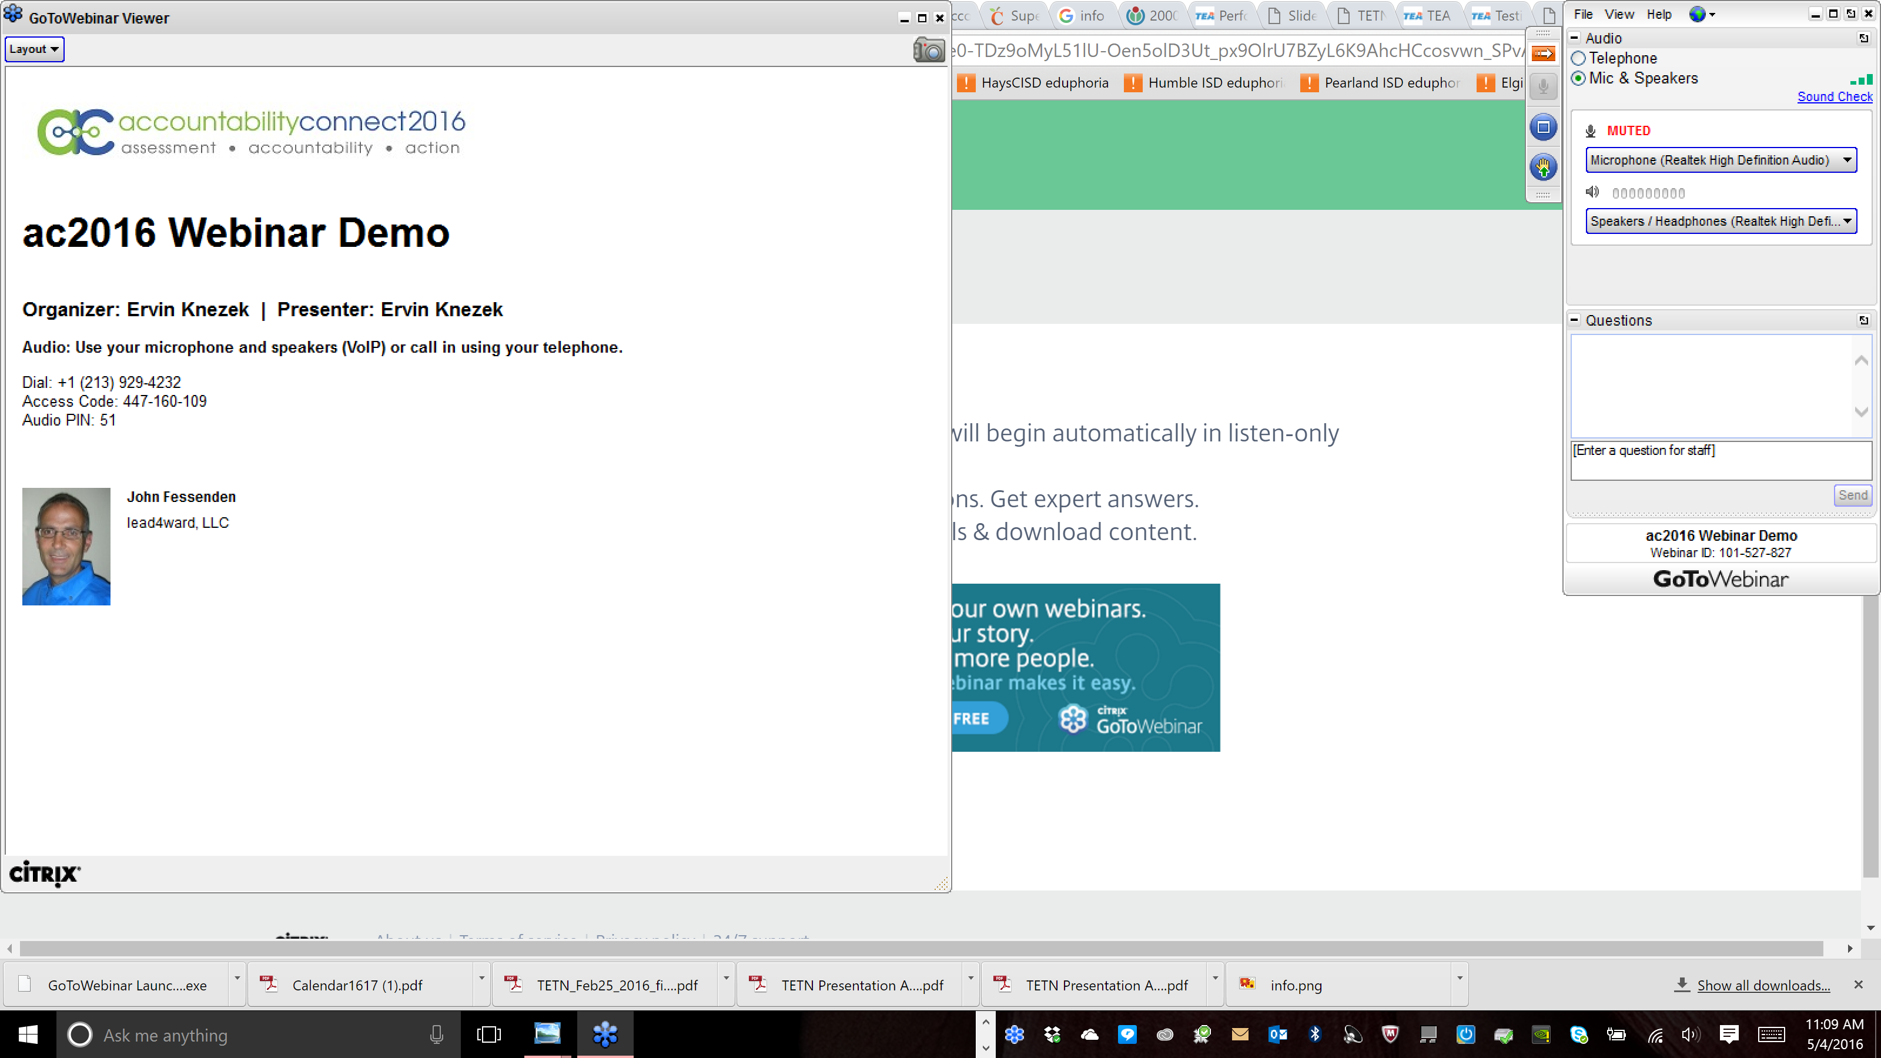

Your Questions

Slide 4
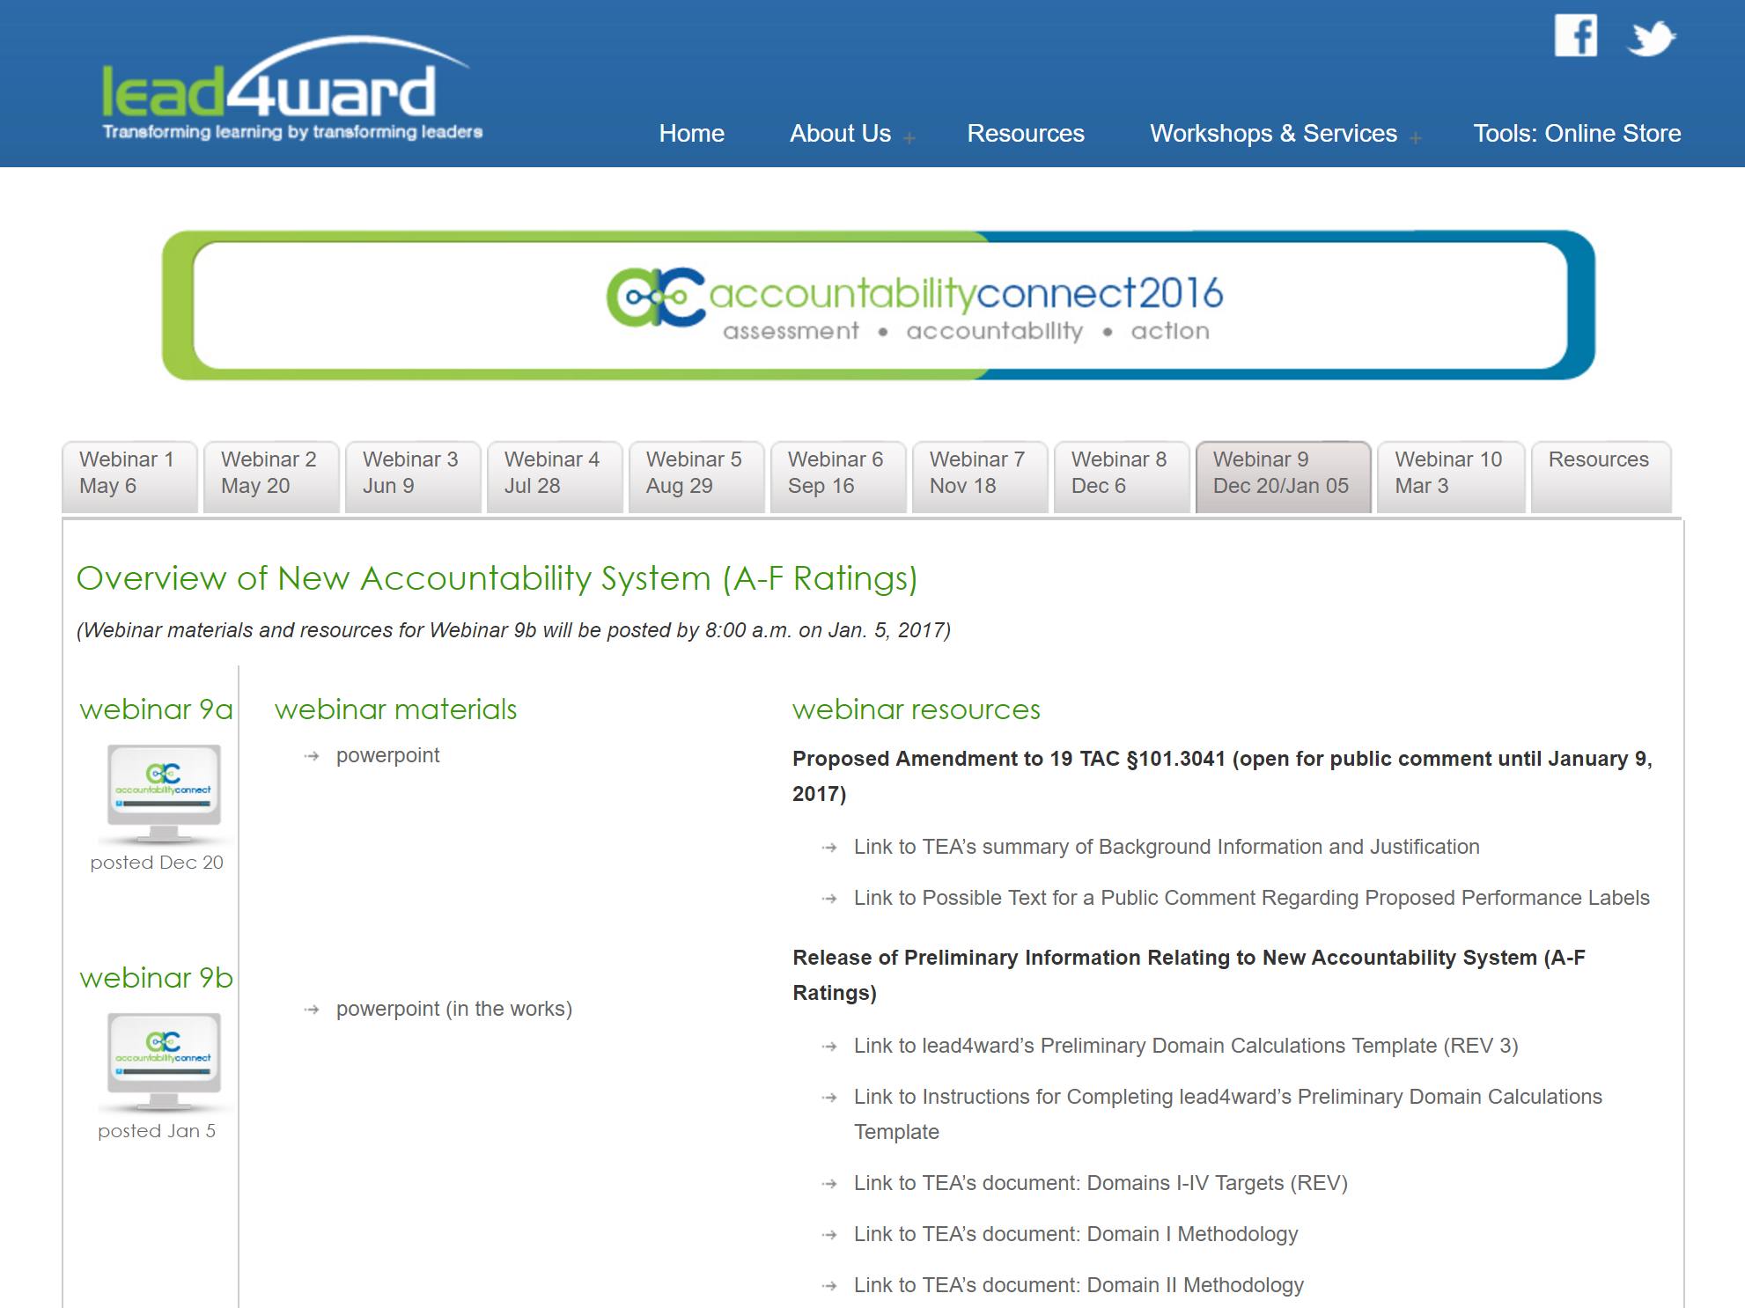
tab 9
resources
recording
ppt

Slide 5

so let’s get started!

Slide 6
PROPOSED commissioner rule relating to STAAR performance standards

Slide 7



In the beginning …
TEA created

Slide 8
STAAR Performance Categories
… from the beginning (Spring 2012)
THIS standard
(Level II)
is to be phased-in over time
Satisfactory
Advanced
Level I
Unsatisfactory
Academic
Performance
Level II
Satisfactory
Academic
Performance
Level III
Advanced
Academic
Performance
Inadequately
Prepared
Sufficiently
Prepared
Well
Prepared
Likely to need significant, ongoing academic intervention
Likely to need short-term, targeted academic intervention
Likely to succeed with little or no academic intervention
Notes:
In order to better understand student performance on STAAR, let’s re-visit the overall design of the test – for both grades 3-8 as well as the EOCs.
STAAR is an assessment that has 2 cutpoints. Those 2 cutpoints divide students into 3 possible performance groups.
The two cut points are labeled: Advanced and Satisfactory.
Students who score below the Satisfactory cut point are categorized as Level I – Unsatisfactory Academic Performance.
Students who score at least Satisfactory but below Advanced are categorized as Level II – Satisfactory Academic Performance.
Students who score at or above Advanced are categorized as Level III – Advanced Academic Performance.
In order to help schools connect STAAR performance to instructional needs of students, TEA developed performance level descriptors that are designed to help identify the general needs of students performing at each performance level.
Students who score Level I on STAAR are students who can generally be described as Inadequately Prepared for the next grade or course. They are unlikely to succeed without significant, ongoing academic intervention.
Students who score Level II on STAAR are students who can generally be described as Sufficiently Prepared for the next grade or course. They have passed the STAAR test, which is good. They are reasonably likely to succeed at the next grade level or course; however, they may need short-term, targeted academic intervention in order to be successful.
Students who score Level III on STAAR are students who can generally be described as Well Prepared for the next grade or course. They have performed at the highest level on the test – and are likely to succeed at the next grade level or course with little or no academic intervention.

Slide 9
Current Phase-in Plan for Level II
“Standard Progression” Model – 19 TAC §101.3041 (effective January 6, 2016)
Began at Phase 1
End at the Final-Recommended Level II standard
Annual incremental increases each year
    2525
    2021-22
    (Final Recommended)
    2020-21
    (+0.15 std dev)
    2019-20
    (+0.15 std dev)
    2018-19
    (+0.15 std dev)
ANY change to this plan requires a formal amendment to
19 TAC §101.3041
    2017-18
    (+0.15 std dev)
    2016-17
    (+0.15 std dev)
    2015-16
    (+0.1 std dev)
    2011-12 through
    2014-15
    (Phase 1:
    1 std dev below Final)

Slide 10
Connecting STAAR Performance Categories and the Level II-Phase-in
Example: Grade 8 Reading
We can map the following scale score cutpoints along the purple continuum line
  Level III Standard (1783)
  Level II–Final Standard (1700)
  2015-16 Standard Progression Standard (1587)
1700
1783
0
1587
2200
Satisfactory
Advanced
Level I
Unsatisfactory
Academic
Performance
Level II
Satisfactory
Academic
Performance
Level III
Advanced
Academic
Performance
Inadequately Prepared
Sufficiently Prepared
Well Prepared
Notes:
So let’s try to show, visually, what is happening during the phase in of the Level II standard.
Let’s look again at our general depiction of the 3 performance categories for STAAR – and then look at the phase in of the Level II standard.
What we can see is that the Level II – Phase 1 standard is actually below the final Level II standard. While students who score at least Level II – Phase 1 are considered to have passed the test, it is important to see that in the long run, a score that is the equivalent of Level II – Phase 1 will be considered a failing score.
Similarly, we can see that when we move to Level II – Phase 2, students will be able to achieve a passing status on the test with what, ultimately, will be considered a failing score.
Only when we arrive at the Final Level II standard will we have fully implemented the overall design of STAAR – with the corresponding descriptions of the relative level of preparedness of students scoring within each Performance Level in STAAR (Level I, Level II and Level III).

Slide 11
the Level II Phase-in is like grading on a curve …
Level II – 2015-16 Std. Progression
Grade 8 Reading = 1587
(≈ 54% correct)
Level II - Final
Grade 8 Reading = 1700
(≈ 75% correct)
Satisfactory
Satisfactory
Advanced
Advanced
Level I
Unsatisfactory
Academic
Performance
Level II
Satisfactory
Academic
Performance
Level III
Advanced
Academic
Performance
Phase-In
Standard
Progression
Inadequately Prepared
Sufficiently Prepared
Well Prepared
Students who meet the Phase-in standard are treated as having achieved “Satisfactory Academic Performance”
Notes:
So let’s try to show, visually, what is happening during the phase in of the Level II standard.
Let’s look again at our general depiction of the 3 performance categories for STAAR – and then look at the phase in of the Level II standard.
What we can see is that the Level II – Phase 1 standard is actually below the final Level II standard. While students who score at least Level II – Phase 1 are considered to have passed the test, it is important to see that in the long run, a score that is the equivalent of Level II – Phase 1 will be considered a failing score.
Similarly, we can see that when we move to Level II – Phase 2, students will be able to achieve a passing status on the test with what, ultimately, will be considered a failing score.
Only when we arrive at the Final Level II standard will we have fully implemented the overall design of STAAR – with the corresponding descriptions of the relative level of preparedness of students scoring within each Performance Level in STAAR (Level I, Level II and Level III).

Slide 12
the level II phase-in has effectively turned STAAR into an assessment with 4 performance levels/categories …
Satisfactory
(at Phase-in)
Postsecondary
Advanced
Level I
Unsatisfactory
Academic
Performance
Level II
Satisfactory
Academic
Performance
Level II
Postsecondary Readiness Academic
Performance
Level III
Advanced
Academic
Performance
% of students scoring Level II Satisfactory (Phase-in) or above
% of students scoring Level II Postsecondary Readiness or above
% of students scoring Level III
Notes:
So let’s try to show, visually, what is happening during the phase in of the Level II standard.
Let’s look again at our general depiction of the 3 performance categories for STAAR – and then look at the phase in of the Level II standard.
What we can see is that the Level II – Phase 1 standard is actually below the final Level II standard. While students who score at least Level II – Phase 1 are considered to have passed the test, it is important to see that in the long run, a score that is the equivalent of Level II – Phase 1 will be considered a failing score.
Similarly, we can see that when we move to Level II – Phase 2, students will be able to achieve a passing status on the test with what, ultimately, will be considered a failing score.
Only when we arrive at the Final Level II standard will we have fully implemented the overall design of STAAR – with the corresponding descriptions of the relative level of preparedness of students scoring within each Performance Level in STAAR (Level I, Level II and Level III).

Slide 13

so … what would the PROPOSED amendment to
19 TAC §101.3041 do?

Slide 14
the proposed amendment to 19 TAC §101.3041 would officially turn STAAR into an assessment with 4 performance levels/categories …
Approaches
Meets
Masters
Did Not Meet Grade Level
Approaches Grade Level
Meets
Grade Level
Masters
Grade Level
Unlikely to succeed in the next grade or course without significant, ongoing academic intervention
Likely to succeed in the next grade or course with targeted academic intervention
High likelihood of success in the next grade or course but may still need some short-term, targeted academic intervention
Expected to succeed in the next grade or course with little or no academic intervention
Notes:
So let’s try to show, visually, what is happening during the phase in of the Level II standard.
Let’s look again at our general depiction of the 3 performance categories for STAAR – and then look at the phase in of the Level II standard.
What we can see is that the Level II – Phase 1 standard is actually below the final Level II standard. While students who score at least Level II – Phase 1 are considered to have passed the test, it is important to see that in the long run, a score that is the equivalent of Level II – Phase 1 will be considered a failing score.
Similarly, we can see that when we move to Level II – Phase 2, students will be able to achieve a passing status on the test with what, ultimately, will be considered a failing score.
Only when we arrive at the Final Level II standard will we have fully implemented the overall design of STAAR – with the corresponding descriptions of the relative level of preparedness of students scoring within each Performance Level in STAAR (Level I, Level II and Level III).

Slide 15
the PROPOSED amendment to 19 TAC §101.3041 would …
Simplify and stabilize STAAR performance standards
  “Officially” establish 4 distinct performance levels
    3 levels of success (low, medium, high)
  Eliminate the confusion of the phase-in plan
  Establish 2015-16 as the base year for the lowest level of success and allow year-to-year comparisons of student performance on a going-forward basis

Slide 16

BUT …
Satisfactory

Slide 17
There are at least 3 statutory references to “Satisfactory Performance” on STAAR in the Texas Education Code
§39.0241 – TEA is required to “determine the level of performance considered to be satisfactory” on STAAR
§39.025 – “satisfactory performance” is the performance level required on EOCs in order for students to graduate
§28.0211 – “satisfactory performance” is the performance level required in connection with SSI
The PROPOSED rule amendment does not clarify what is considered
SATISFACTORY

Slide 18
the PROPOSED labels for each performance level seem to be confusing and misleading …
Approaches
Meets
Masters
Did Not Meet Grade Level
Approaches Grade Level
Meets
Grade Level
Masters
Grade Level
% of students scoring at or above “Approaches Grade Level”
“Approaches Grade Level” does not seem to connote “Satisfactory Performance”
Seems likely to confuse students and parents
Seems misleading – students are NOT taking below-grade-level tests
% of students scoring at or above “Meets Grade Level”
% of students scoring “Masters Grade Level”
Notes:
So let’s try to show, visually, what is happening during the phase in of the Level II standard.
Let’s look again at our general depiction of the 3 performance categories for STAAR – and then look at the phase in of the Level II standard.
What we can see is that the Level II – Phase 1 standard is actually below the final Level II standard. While students who score at least Level II – Phase 1 are considered to have passed the test, it is important to see that in the long run, a score that is the equivalent of Level II – Phase 1 will be considered a failing score.
Similarly, we can see that when we move to Level II – Phase 2, students will be able to achieve a passing status on the test with what, ultimately, will be considered a failing score.
Only when we arrive at the Final Level II standard will we have fully implemented the overall design of STAAR – with the corresponding descriptions of the relative level of preparedness of students scoring within each Performance Level in STAAR (Level I, Level II and Level III).

Slide 19
is there anything that can be done?
Yes …
  The amendment to 89 TAC §101.3041 was PROPOSED on December 9, 2016
  It remains open for public comment until January 9, 2017
  Public comment can be submitted by email to: rules@tea.texas.gov
  A document with possible language for a comment is posted on the ac2016 website for Webinar 9

Slide 20
summary of posted document
Support the recommendation to replace the current Level II phase-in plan with a final set of standards to indicate 4 levels of student performance on STAAR
Urge the Commissioner to revise the performance labels contained in the proposed revision to §101.3014 as follows:
Performance Label in Proposed Rule | Suggested Change to Performance Label
Did Not Meet Grade Level → | Unsatisfactory Grade Level Performance
Approaches Grade Level → | Satisfactory Grade Level Performance
Meets Grade Level → | Proficient Grade Level Performance
Masters Grade Level → | Advanced Grade Level Performance

Slide 21

PROPOSED commissioner rule relating to STAAR performance standards

Slide 22
the new accountability system
(a-f ratings)

Slide 23


on december 16th we received a gift!
Tables!
And Summaries!
And Targets!
Oh my!
To: School Districts
Love: TEA
* Some assembly required

Slide 24

so what did we get?
Data Tables for Domains I, II, III and IV
Summary Methodologies for Domains I, II, III and IV
Domain Targets for each letter grade for each campus type
According to TEA,
  “Districts may calculate their 2015–16
  A–F ratings using [these] resources and 2016 accountability data”

Slide 25

cx
CXZ

Slide 26

so can we do it?
Yes we can!

Slide 27
what is needed?
lead4ward Domain Score Calculation Template (with instructions for completing)
  Posted on ac2016 webpage – Webinar 9
Data Tables for Domains I, II, III and IV
  Posted on TEASE for the district and each campus
2016 Index 2 Calculation Report
  For the district and each campus
2016 Index 4 Calculation Report
  For the district and each high school campus

Slide 28
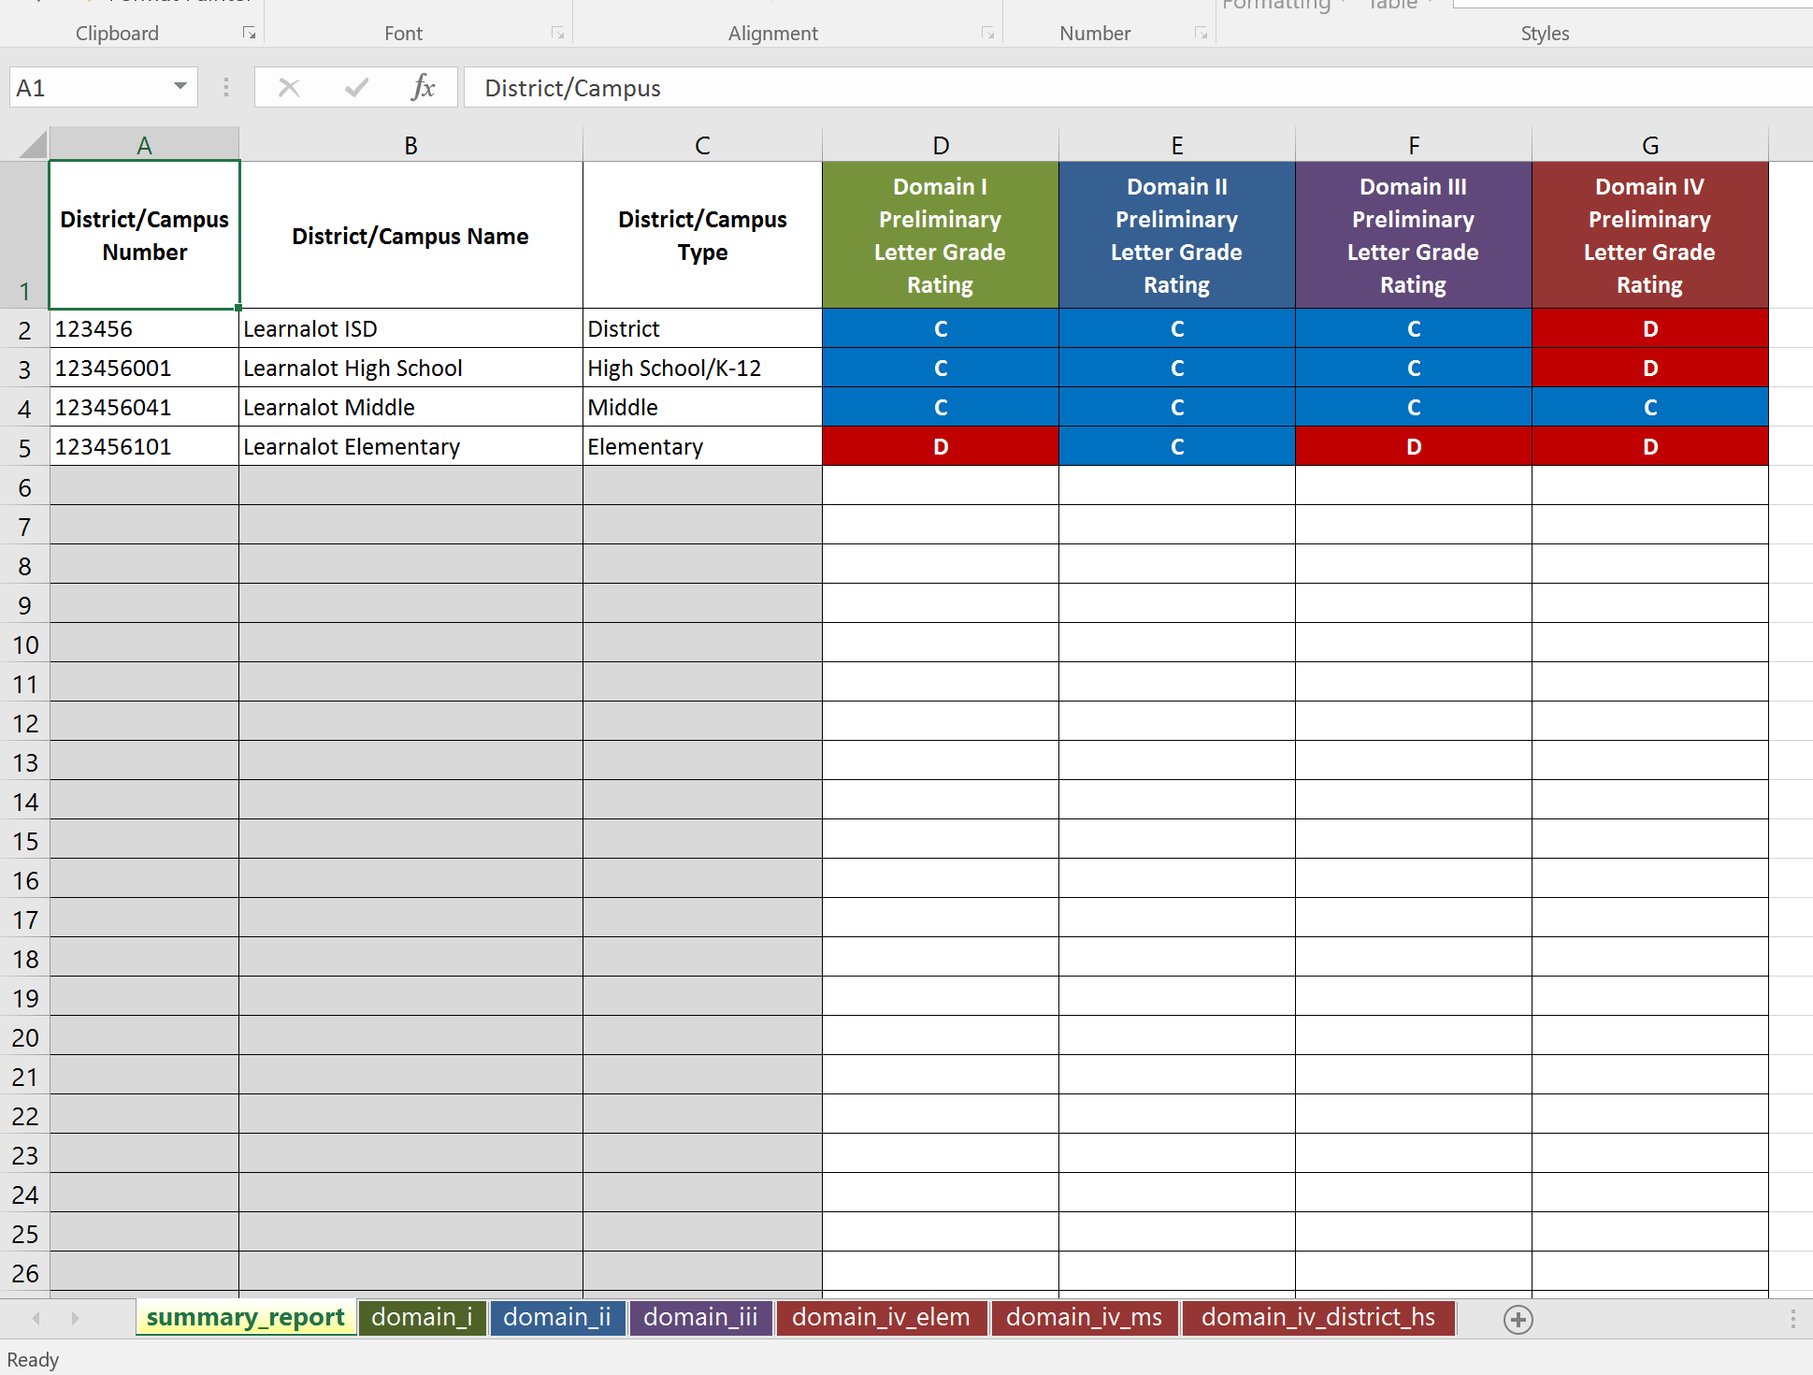
Completed Template

Slide 29


The Template:
Domain Scores and Letter Grades

Slide 30
but the Domains are more than just a score
What is being measured/evaluated in each Domain?
And, more importantly, what do we DO?
NEW quicklook
(posted as a resource on the Webinar 9 Tab)

Slide 31
Domain I:
Student
Performance

Slide 32
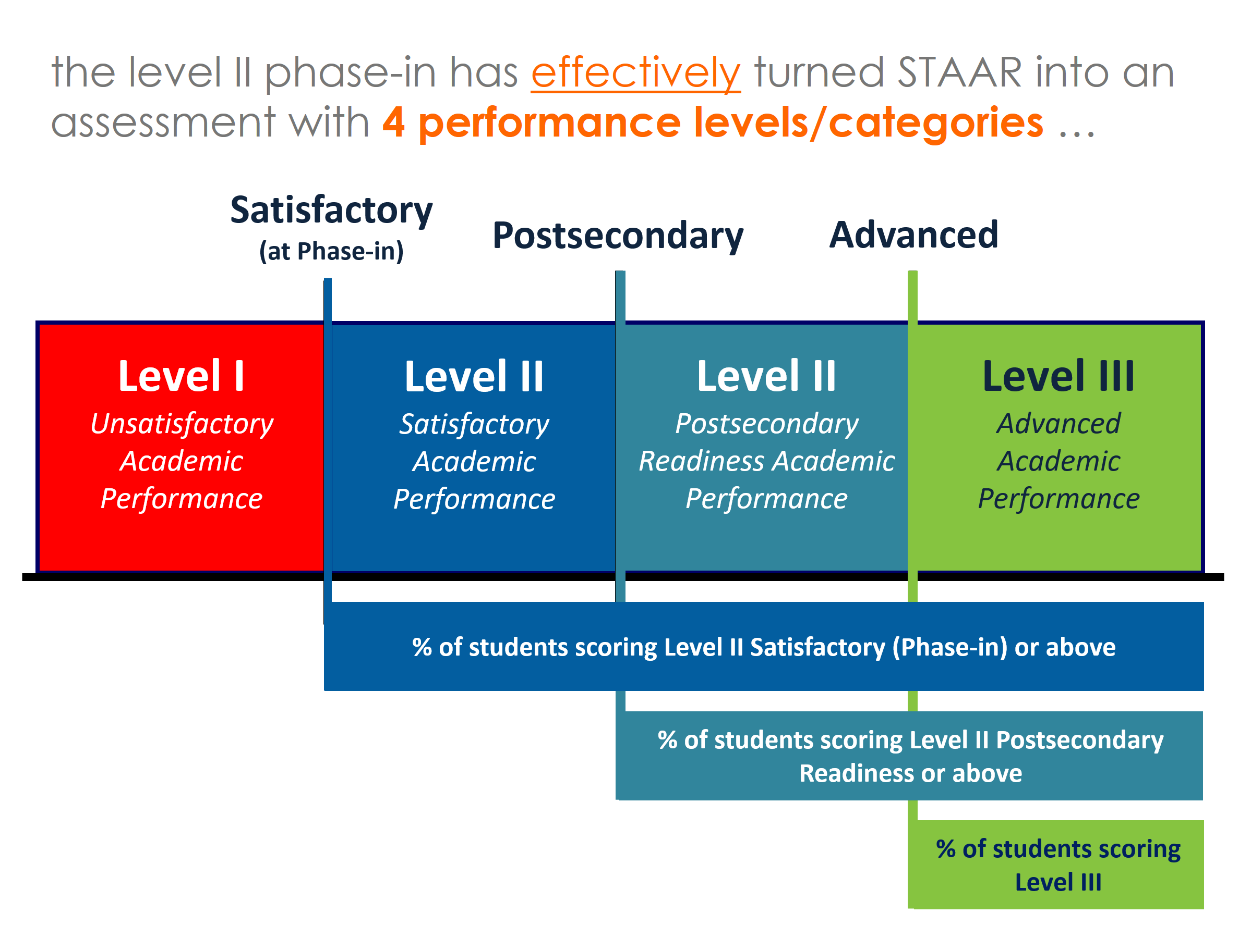
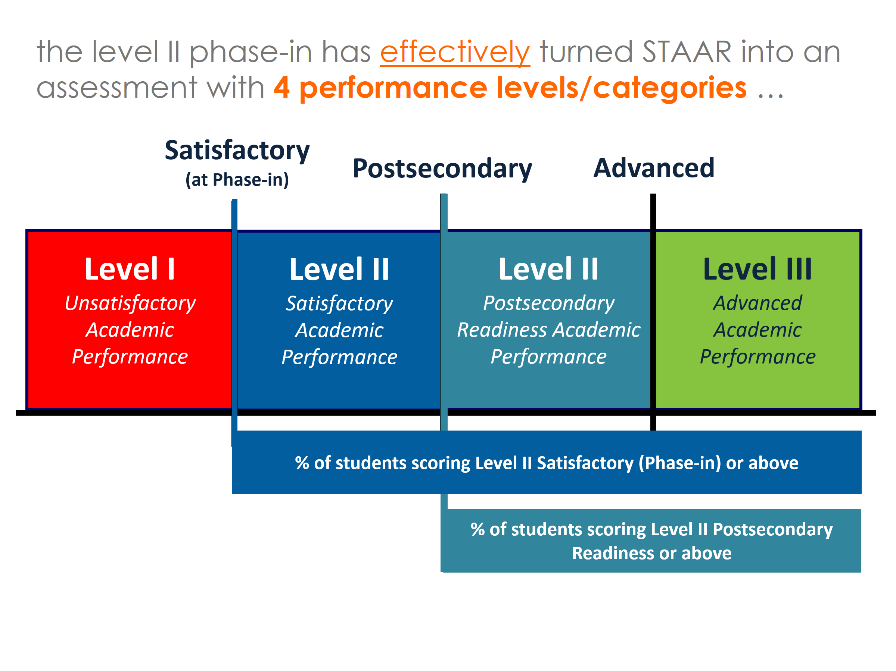
This is what TEA decided to include in Domain I
This is what HB 2804 REQUIRES to be included in Domain I

Slide 33
Single Measure:
All tests, all subjects, all grade levels/courses
(Similar to Index 1)

Slide 35
Total Points Earned = 70.2 + 34.4 + 11.9 = 116.5
116.5 ÷ 300 = 38.8 … which rounds to 39

Slide 36
Middle School
Domain I Score = 39
Domain I Grade = C

Slide 37
Illustrating Domain I
Campus A has very low %ages of students passing at either of the higher standards
Result: a low letter grade
Campus B has much higher %ages of students passing at the higher standards
Result: a high letter grade
Both campuses would
“Meet Standard” for Index 1 with a score of 60
 | Campus A | Campus B
% Satisfactory Standard or above | 60.0 | 60.0
% Postsecondary Readiness Standard or above | 20.0 | 55.0
% Advanced Standard | 5.0 | 45.0
Total Points Earned | 85.0 | 160.0
÷ 300 | 28.3 | 53.3
Domain I Score | 28 | 53
Domain I Grade | F | B
The lowest level of success on STAAR (“Phase-in” or “Approaches”) simply isn’t enough

Slide 38
passing at the lowest standard on STAAR is NOT enough
Satisfactory
(at Phase-in)
Postsecondary
Advanced
Level I
Unsatisfactory
Academic
Performance
Level II
Satisfactory
Academic
Performance
Level II
Postsecondary Readiness Academic
Performance
Level III
Advanced
Academic
Performance
% of students scoring Level II Satisfactory (Phase-in) or above
% of students scoring Level II Satisfactory (Phase-in) or above
Achieve
Focus on Level II-Final (Postsecondary Readiness)
% of students scoring Level II Postsecondary Readiness or above
% of students scoring Level III
Notes:
So let’s try to show, visually, what is happening during the phase in of the Level II standard.
Let’s look again at our general depiction of the 3 performance categories for STAAR – and then look at the phase in of the Level II standard.
What we can see is that the Level II – Phase 1 standard is actually below the final Level II standard. While students who score at least Level II – Phase 1 are considered to have passed the test, it is important to see that in the long run, a score that is the equivalent of Level II – Phase 1 will be considered a failing score.
Similarly, we can see that when we move to Level II – Phase 2, students will be able to achieve a passing status on the test with what, ultimately, will be considered a failing score.
Only when we arrive at the Final Level II standard will we have fully implemented the overall design of STAAR – with the corresponding descriptions of the relative level of preparedness of students scoring within each Performance Level in STAAR (Level I, Level II and Level III).

Slide 39
what can we DO?
ACHIEVE at Level II Final
(from webinars 5, 6 and 7)

Slide 40

focus on
Level II
Final

Slide 41
Suggestion:
Use 70% on local assessments
Both campuses would

Slide 42
Local Assessment Results
  Stop using % Passed/% Failed analysis
  Analyze 3 performance categories
  Set passing at 70% and advanced at 90%
  Start with Advanced
% Advanced (90 or above) | % Satisfactory (70 to 89) | % Unsatisfactory (Below 70)
5%
65%
30%

Slide 43
Domain II:
Student Progress

Slide 44
TEA chose to use Index 2 as Domain II
The Progress Measure used for Index 2 is based on STAAR Progress toward Level III
Domain II is likely to change before implementation of official A-F ratings in August 2018

Slide 45
The Domain II methodology that TEA used for the Legislative Report is EXACTLY the same as
Index 2
That means our Domain II score
is EXACTLY the same as our Index 2 score

Slide 46
The difference between Domain II and Index 2 is the evaluation of the score
For 2016 Accountability, the targets to meet Index 2 were
  ES = 32
  MS = 30
  HS = 17
  District = 22
For A-F ratings, the targets to earn a D were all set ABOVE the Index 2 targets
As a result, as large number of campuses that MET the Index 2 target were assigned an F under the A-F methodology
  424 Elementary Campuses
  158 Middle School Campuses
  112 High Schools

Slide 47
so how were the Domain II letter grades distributed?
Campus Type | # Campuses | % F's | % D's | % C's | % B's | % A's
Elementary | 4276 | 14.7% | 18.1% | 33.3% | 22.8% | 11.2%
Middle | 1638 | 14.3% | 20.1% | 35.2% | 17.6% | 12.8%
High School/K-12 | 1588 | 11.3% | 22.5% | 34.0% | 20.8% | 11.4%
Total | 7502 | 13.9% | 19.5% | 33.8% | 21.2% | 11.6%
the distribution of Domain II letter grades across all 3 campus types looks like this

Slide 48
what can we DO?
BELIEVE in Progress
(from webinars 5, 6 and 7)

Slide 49
focus on
progress

Slide 50
STAAR Progress
General Rule:
    To Meet Progress a student needs to perform about as well on this year’s curriculum as he/she did on last year’s curriculum
    Meeting Progress does NOT mean that the student has performed significantly better this year
    It just means that the student has not moved backwards
The mindset: don’t let kids go backwards

Slide 51
the meet progress mindset … keep it simple!
77%
84%
70%
70%
68%
59%
68%
84%
48%
84%

Slide 52
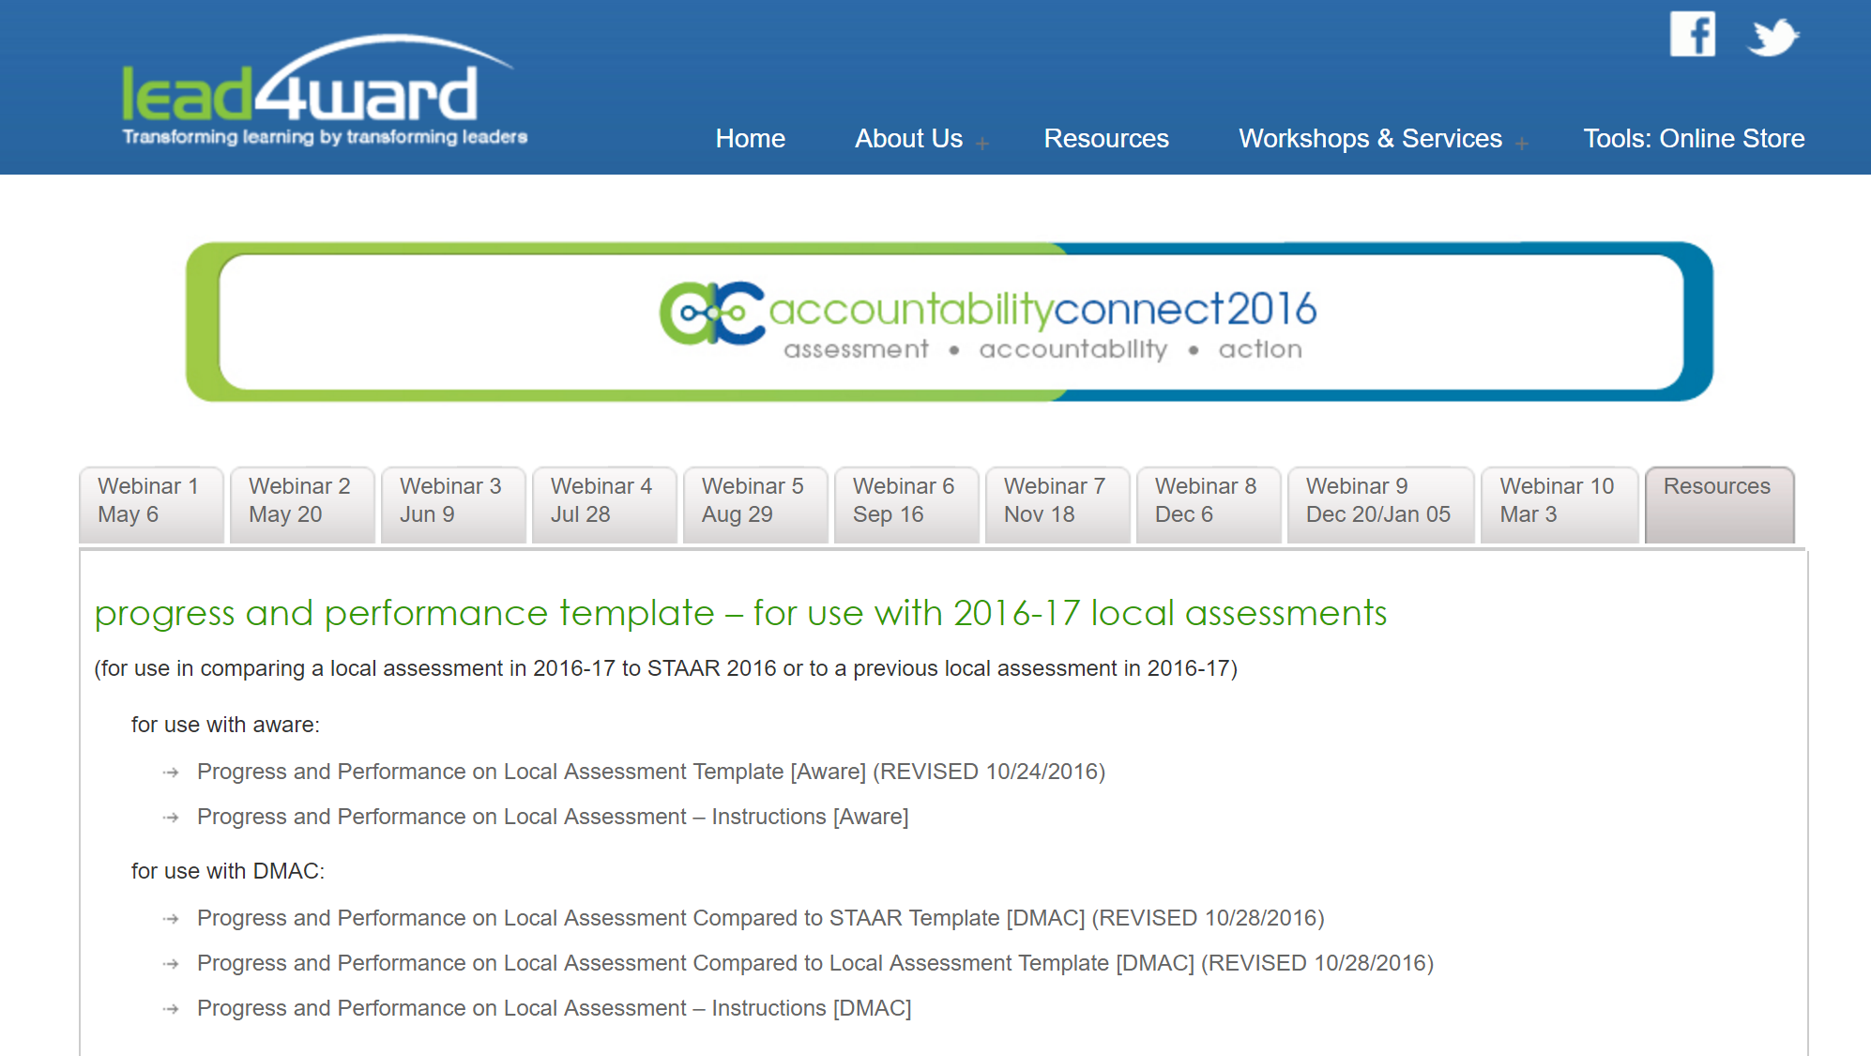
Progress and Performance Matrix
– Local Assessments (eduphoria and DMAC)
  Identify what helps students make Excellent Progress
  Focus attention on making Satisfactory Progress
  Intervene to address students who are going backward
Resources

Slide 53
Domain I and
Domain II

Slide 54
Domain III:
Closing Performance Gaps

Slide 55
TEA chose to use a regression analysis evaluation for Domain III
ONLY includes EcoDis student group
No race/ethnicity groups

Slide 56
The Construction and the Indicators for Domain III are identical to Domain I … EXCEPT they are applied to the EcoDis student group instead of the All Students group

Slide 57
Domain III Score
ACTUAL Domain I Score
(for EcoDis Student Group)
PREDICTED Domain I Score
(for EcoDis Student Group)
=
–

Slide 58
Letter Grade is then determined based on the
Domain III Score

Slide 59
dfas
asdf

Slide 60

got it?

Slide 61
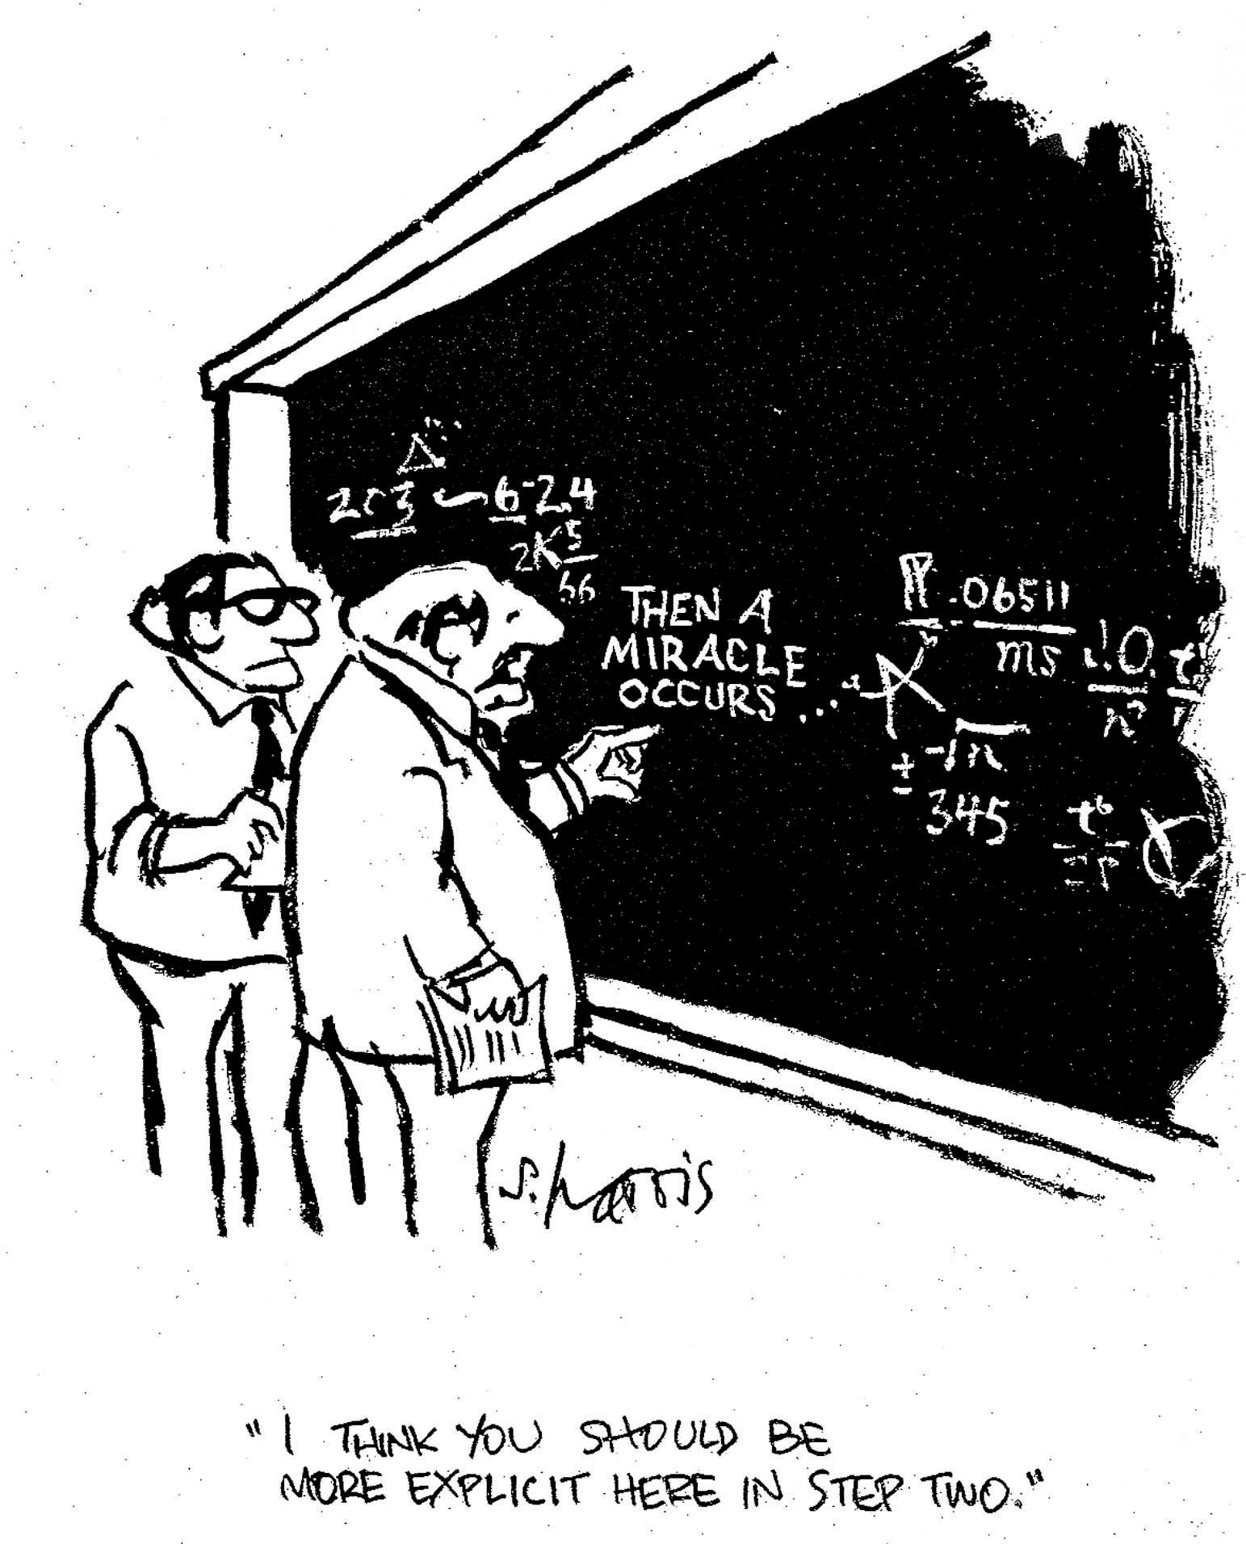
so what’s really going on in Domain III?

Slide 62
This chart maps performance of Middle School campuses
y axis
65.5 + 29.1 = 8.9 = 103.5
103.5 ÷ 300 = 34.5
… which rounds to 35
This campus:
% EcoDis = 8.0%
Domain I Score for EcoDis = 40
This campus:
% EcoDis = 67.6%
Domain I Score for EcoDis = 35
TEA created a scatter plot chart based on 2015-16 STAAR performance of EcoDis students
Each campus type or district was mapped on a separate chart
Two variables:
  % of EcoDis students (x axis)
  Domain I score for the EcoDis Student Group (y axis)
Each dot on this chart represents a middle school campus
x axis

Slide 63
TEA then ran a regression analysis to determine the line of best fit based on the performance of all represented campuses

Slide 64
This line is represented by the equation
y = mx + b
For middle schools, this line is
  y = –.18288 x + 47.49244
  y = PREDICTED Domain I Score for the EcoDis Student Group
  x = % of EcoDis students on campus

Slide 65
This campus’ ACTUAL Domain I Performance is ABOVE what would be PREDICTED for a campus having the same %age of EcoDis students
For each campus, TEA then compared:
ACTUAL Domain I Performance of the EcoDis Student Group at the campus (green dot)
to
PREDICTED Domain I Performance of the EcoDis Student Group for a campus with the same %age of EcoDis students (purple line)
This campus’ ACTUAL Domain I Performance is BELOW what would be PREDICTED for a campus having the same %age of EcoDis students

Slide 66
Now let’s look at Domain III Targets for Middle Schools
Remember the Domain III Equation:
ACTUAL
Domain I Score
(for EcoDis Student Group)
–
PREDICTED
Domain I Score
(for EcoDis Student Group)
=
Domain III Score
F
(if score is < -9.6)
D
(if score is ≥ -9.6 but < -1.9)
C
(if score is ≥ -1.9 but < 1.9)
B
(if score is ≥ 1.9 but < 9.6)
A
(if score is ≥ 9.6)

Slide 67
To see how this works, let’s look at 5 Middle School campuses with an identical %age of EcoDis students (67.6%)

Slide 69
Domain III Score = 11.9
(Actual – Predicted = 11.9)
So Letter Grade = A
Domain III Score = 5.9
(Actual – Predicted = 5.9)
So Letter Grade = B
Domain III Score = 0
(Actual – Predicted = 0)
So Letter Grade = C
Domain III Score = -7.1
(Actual – Predicted = -7.1)
So Letter Grade = D
Domain III Score = -13.1
(Actual – Predicted = -13.1)
So Letter Grade = F

Slide 70
dfas
asdf

Slide 71
what can we DO?
CONCEIVE success for ALL students
(an extension from webinars 5, 6 and 7)

Slide 72
Local Assessment Results
  Stop using % Passed/% Failed analysis
  Analyze 3 performance categories
  Set passing at 70% and advanced at 90%
  Start with Advanced
% Advanced (90 or above) | % Satisfactory (70 to 89) | % Unsatisfactory (Below 70)
5%
65%
30%
Progress and Performance Matrix
– Local Assessments
  Identify what helps students Exceed Progress
  Intervene to address students who Did Not Meet Progress
Pay particular attention to EcoDis students

Slide 73
Domain IV:
Postsecondary Readiness

Slide 74
For Districts/High Schools, TEA decided to weight the components of Domain IV as follows:
  Graduation Rate = 10% of the overall grade (28.6% of Domain IV Score)
  Graduation Plan = 5% of the overall grade (14.3% of Domain IV Score)
  College and Career Ready Graduates = 20% of the overall grade (57.1% of Domain IV Score)
For Middle Schools for the Legislative Report, TEA decided to use:
  Converted Chronic Absenteeism Rate [in place of Attendance Rate]
  Converted Annual Dropout Rate
  (With no inclusion of students receiving instruction in preparing for
  high school, college, and career at this point)
For Elementary Schools, TEA decided to use Converted Chronic Absenteeism Rate
[in place of Attendance Rate]

Slide 76
Chronic Absenteeism Rate (CAR)
Determine the students who were enrolled in membership for at least 83% of the days of the school year
  83% = 5/6 of the school year
  These are the “non-mobile” students
Of the non-mobile students, determine how many were absent at least 10% of the days they were enrolled
Calculate the percentage of non-mobile students who were absent at least 10% of the days they were enrolled
Subtract this percentage from 100 to determine the score for this indicator
Although it is called Chronic Absenteeism, the score is actually the percentage of students who are not chronically absent (TEA could have called this “Non-Chronic Absenteeism” instead of “Chronic Absenteeism – Conversion”)
TEA calculated this indicator using 2015-16 Attendance Data – even though that data would NOT have been available in time for a 2015-16 A-F Rating to be issued
(the actual 2015-16 A-F rating would have come from the 2014-15 school year)

Slide 77
Annual Dropout Rate - Conversion
Determine:
  # of students from grades 7-8 reported as dropouts from the 2014-15 school year (Fall 2015 PEIMS Submission)
  # of students enrolled in grades 7-8 during the 2014-15 school year (Summer 2015 PEIMS Submission)
Divide the # of students in grades 7-8 reported as dropouts from the 2014-15 school year by the # of students enrolled in grades 7-8 during the 2014–15 school year
# of grade 7-8 students reported as dropouts
# of grade 7-8 students enrolled during the school year
Because the annual dropout rate is a measure of negative performance (i.e., a low score is a good score) it must be “transformed” into a positive measure in order to be used as a component of the Domain IV score
So TEA converts the annual dropout rate into a positive measure by using the following equation:
100 – (Annual Dropout Rate x 10)*
The * means that the lowest converted annual dropout rate TEA will report is 0

Slide 78
Graduation Rate for Domain IV = Graduation Rate used for Index 4
Graduation Plan Rate for Domain IV = Graduation Plan Rate used for Index 4
College and Career Ready Graduates Rate for Domain IV ≠ Postsecondary Readiness Component used for Index 4
  Completed a CTE-coherent sequence of courses (appears to be the same as used in Index 4)
  Completed 12 or more hours of postsecondary credits (not included in Index 4)
  Completed 1 or more AP/IB courses (Index 4 required 2 or more courses)
  Met TSI benchmark on TSIA, SAT, or ACT (appears to be the same as used in Index 4)

Slide 79
Domain IV scores for elementary and middle schools are rounded to the tenths place
Targets are all 90.0 or above

Slide 80
Domain IV score =
(Graduation Rate Score x 0.286) + (Graduation Plan Rate Score x 0.143) + (CCR Graduates Score x 0.571)

Slide 81
what can we DO?
Review Legislative Report for more details about Domain IV and continue to monitor attendance, dropout and graduation

Slide 82
Domain III and
Domain IV

Slide 83
what’s next?
January 6, 2017: Legislative Report will be available to the public
Development of A-F system will continue until the Spring of 2018
What TEA has released is NOT final

Slide 84
what do we DO?
Focus on continuity of concepts, NOT complexity of calculation
Index 1 = Performance → Domain I = Performance
Index 2 = Progress → Domain II = Progress
Index 3 = Eco Dis Performance → Domain III = Eco Dis Performance
Index 4 = Readiness → Domain IV = Readiness
Spring 2017 – focus on instruction, NOT A-F ratings

Slide 85
remember the ABCs
Achieve
Believe
Conceive
  at Level II-Final (or “Meets Grade Level”)
  in student progress (no one goes backward!)
  success for all students (particularly EcoDis!)

Slide 86



next scheduled webinar
Webinar #10
  Accountability 2017 Preview
    Friday, March 3, 2017
    9:00 a.m. to 10:30 a.m. Central Time
BUT … a special webinar to review the Legislative Report and discuss updates could be held in mid-to-late January

Slide 87
Your Questions

Slide 88
Thank you!
John Fessenden
john@lead4ward.com
512-560-7784

